Slide 1
New GSKY Client Software Apps
Exploring client apps other than TerriaMap
Copyright © 2019 by National Computational Infrastructure, Canberra, ACT, Australia. All Rights Reserved.
Author: Arapaut V. Sivaprasad.
11 March, 2018

Slide 2
Objectives
TerriaMap is the only tested client for GSKY
Less known to the wide world
Explore how GSKY can be used with other clients
Create examples and tutorials
Implement a DAP service in GSKY
Next: Potential GSKY Clients

Slide 3
Potential GSKY Clients
Application | Comments | GSKY
ArcGIS | Most widely used GIS software | Works on 4 out of 6 App veriants
QGIS | Widely used and VDI-integrated | Works on v3.4
AUSGIN | Australian Geoscience Information Network | Works on Production GSKY server
NASA World View (Web) | Not directly suitable for GSKY | No WMS layer addition facility
NASA World Wind (App) | Not directly suitable for GSKY | No WMS layer addition facility
NASA World Explorer (Web) | Powered by NASA World Wind | Works on Production GSKY server
NASA Web World Wind (Web) | Powered by NASA World Wind | Works on Production GSKY server Can build our own web apps.
Auscope | Parallel service to AusGIN | Works on Production GSKY server
Google Earth | Very popular software | WMS facility does not work
Next: Potential Clients Described

Slide 4

Potential Clients Described
Claimed to be “the world's most powerful mapping and analytics software”
Commercial app from Environmental Systems Research Institute (ESRI)
Six different apps in the suite.
All except one are Windows’ apps.
ArcGIS Pro and ArcGIS have several tools and analyses to help extend the usability of GSKY. For example, the “Living Atlas” has a large number of publicly available maps that can be layered over the GSKY layers for comparison analysis.
There are input tools to retrieve info from the map. For example, ‘Viewshed’ returns polygons of visible areas for a given set of input points.
This tutorial does not have the scope of understanding the whole set of tools and analyses options. However, it would be useful to work out which of these will be relevant to GSKY and create descriptive tutorials on them. Perhaps we may to modify GSKY to create the data required for some analyses.
The possibilities are virtually endless if we can somehow integrate GSKY with ArcGIS Pro/Online.
ArcGIS Pro
Most comprehensive app in the suite.
Works well with GSKY.
ArcGIS Online
Online version of ArcGIS Pro.
Not as comprehensive as the desktop version.
Works well with GSKY on production server.
ArcGIS Earth
Relatively simpler to learn.
Alternative to Google Earth for corporate users.
Works with GSKY but has errors.
Next: Other ArcGIS Apps

Slide 5
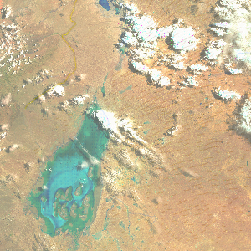
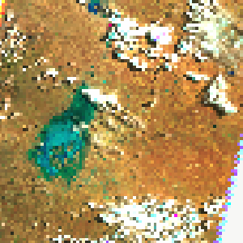
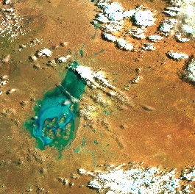
Other ArcGIS Apps
These are similar software and share the data between them.
Only ArcMAP is working with GSKY.
ArcMap
No-frills app within the ArcGIS suite
Works well with GSKY
Low picture quality
TerriaMap
ArcMap
ArcGlobe
Do as below to see the higher resolution image.
For ArcGIS Pro/Map:
Display the layer in full window mode.
Center the area to be viewed.
Go out of full window mode.
Click and drag the window as small as possible without losing the required area.
Unlike in other apps, where resizing also resizes the image, here the image will stay at the same size but becomes higher resolution.
Pan the image slightly so hat it is redrawn.
Disadvantage is that you can only see a small section at a time.
3D base map.
Does not add the GSKY layer
Maybe fixable
ArcScene
No base map (?!)
Does not add the GSKY layer
Maybe fixable
ArcMap – small canvas
Next: ArcGIS Alternatives

Slide 6
ArcGIS Alternatives
There are several free alternatives to ArcGIS.^{[Ref]}
Not explored
Probably low user base
GRASS
Developed under US Govt grant in 1982
Python console
uDIG
Public domain program
gvSIG
Public domain program
Next: ArcGIS Pro Desktop

Slide 7
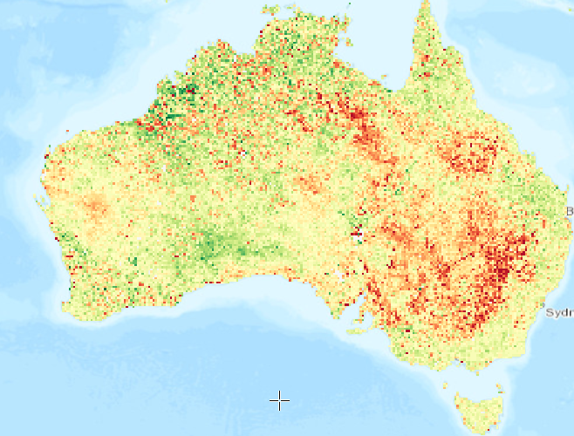
ArcGIS Pro Desktop App
ArcGIS Pro
Tutorial: https://github.com/.../ArcGIS_Pro_Desktop_Tutorial.pptx
Installation, activation and configuration.
Add GSKY Web Map Service.
Advanced use of ArcGIS Pro using an example.
Dozens of free public domain layers and base maps.
e.g. Natural water layer, buildings, roads, forests, MacDonalds!
Attribute tables and many analysis methods.
Python console and built-in tools.
Learning this app fully is about as easy as escaping from the path of a cyclone.
Next: ArcGIS Online

Slide 8
ArcGIS Online
ArcGIS Online
Tutorial: https://github.com/.../ArcGIS_Online_Tutorial.pptx
Requires an ArcGIS Online account (ANU Institutional Licence)
https://www.arcgis.com/home/index.html
It has many features of ArcGIS Pro and is platform independent.
Publish your work:
ArcGIS Online has a facility to publich your maps and layers on the ArcGIS server so that others can view and work with them.
Publishing your work requires a licence that has ‘Publish’ privileges. When you apply for an ANU Organisational licence you will get an ‘ANUStandard’ account which does not have this privilege. You must request for an upgrade to ‘ANUPublisher’ or ‘ANUStudent’ level.
FSES is reluctant to give ANUPublisher account but may give ANUStudent account if you ask very politely, gently and saying how much obliged you will be, etc. (: So far, my account is the only one with an ANUStudent status across all of ANU and there is no ANUPublisher.
There is a nominal cost involved in publishing. It is deducted from your ‘available credit’ that comes with the account. Unsure as yet how to apply for more credits.
Simple Use:
Create a map
Add a layer
Set map for share
Advanced Use:
Add demographic data
Style the layer with attribute data
Normalise the style data
Customise the Pop-up
Create a web App and share its URL
Add GSKY Web Map Service…
Works well with GSKY on production server.
Next: ArcGIS Earth

Slide 9

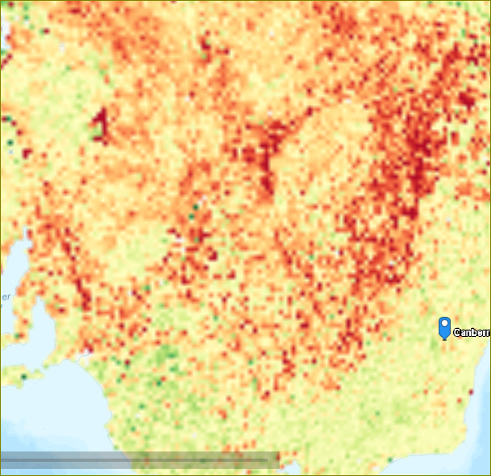
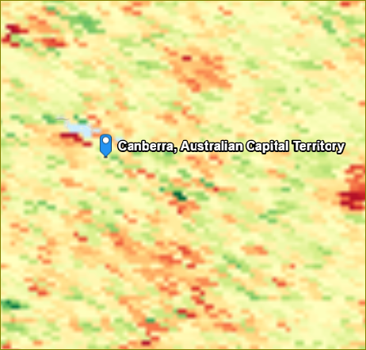
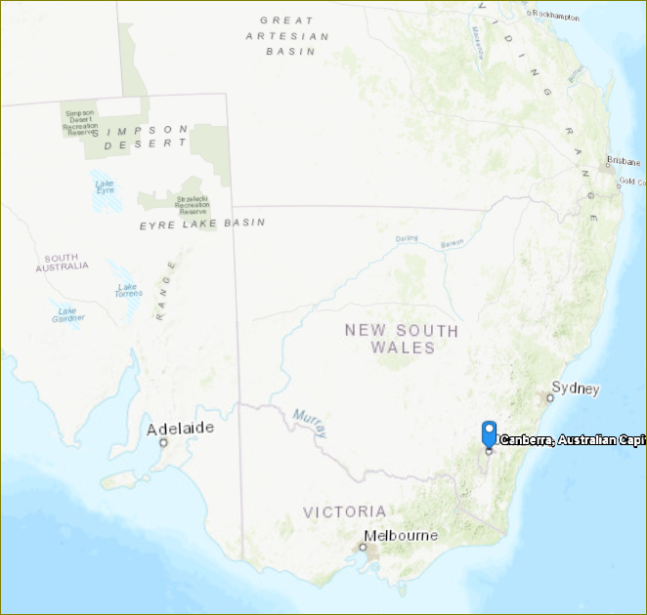
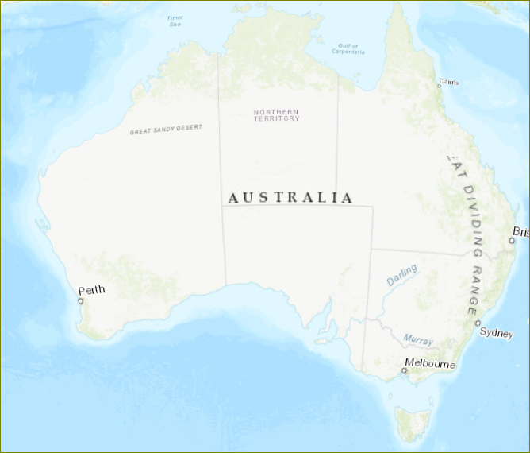
ArcGIS Earth
ArcGIS Earth
Tutorial: https://github.com/…/ArcGIS_Earth_Tutorial.pptx
Requires an ArcGIS Desktop Advanced Licence.
Requires additional step to install.
Windows desktop only.
Much simpler to use than others.
Alternative to Google Earth.
Only 3D map is available.
Add GSKY Web Map Service…
Works with GSKY but goes blank at lower zoom levels.
The layer disappears. This needs to be looked at in GSKY code. Looks like the zoom limit changes somehow.
Next: Google Earth

Slide 10

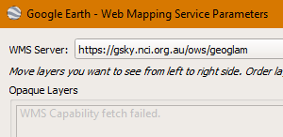
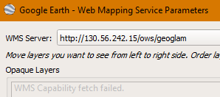
Google Earth
Google Earth
Tutorial: Not yet done.
Free software from Google.
The WMS service is not working with Google Earth (GE), and it appears to be a general issue than specific to GSKY. None of the example URLs they have included in the program works either.
It is calling the GSKY server with the following query:
query: map[version:[1.1.1] request:[GetCapabilities] service:[WMS]]
GSKY server is processing the query without any error. However, GE interprets the return value as error and says “WMS Capability fetch error”. Hence, no further calls to ‘service=WMS’ is arriving.
Perhaps we could try to get some help through the Google Developer’s forum. Will investigate and post here later.
Very widely used.
Has WMS capability.
Not connecting to GSKY servers yet.
query: map[service:[WMS] version:[1.1.1] request:[GetCapabilities]]
Next: QGIS

Slide 11


QGIS
QGIS
Tutorial: https://github.com/.../QGIS_Desktop_Tutorial.pptx
Free and open source program.
Windows, Mac and VDI versions.
QGIS is almost as comprehensive as ArcGIS Pro and is a free software. It can be installed on Mac as well as on Windows and Linux.
There is a VDI-integrated version as well. However, there are issues.
The v2.14 does not work with GSKY.
The v3.4 is currently having issues, which will be fixed. As a workaround, it is possible to start it as commandline in an SSH session. It will be documented in the above tutorial.
About as complex as ArcGIS Pro.
Large number of options and settings.
Add GSKY Web Map Service…
Works well with GSKY.
Only the latest version, 3.4.x, works with GSKY.
Next: AusGIN

Slide 12
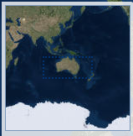

AusGIN
AUSGIN
Tutorial: Not yet done.
Free and web based service.
Provided by Geoscience and various Australian state governments.
This is somewhat like TerriaMap. There are five base maps to choose from and the layers get added relatively quickly. Almost as good user experience as TerriaMap. No analysis facilities and tools like in ArcGIS.
Layers and text data can be published by asking them. Unsure how/whether it can be done.
Pre-made layers.
Facility to add own layers.
WMS layer facility.
http://portal.geoscience.gov.au/
Add GSKY Web Map Service…
Works well with GSKY on production server.
Next: Auscope

Slide 13


Auscope
Auscope
Tutorial: Not yet done.
Free and web based service.
Based in Uni of Melbourne and funded by NCRIS.
This is somewhat like TerriaMap and AusGIN. There is only a simple base map with no option to change it. Almost as good user experience as TerriaMap. No analysis facilities and tools like in ArcGIS.
Layers and text data can be published by asking them. Unsure how/whether it can be done.
Pre-made layers.
Facility to add own layers.
WMS layer facility.
http://portal.auscope.org.au/
Add GSKY Web Map Service…
Works well with GSKY on production server.
Next: NASA World Wind

Slide 14


NASA World Wind
World Wind
Tutorial: Not done.
Free and open source program.
Maps and layers provided by various organisations.
Build your own 3D globe application from the SDK.
Make and publish your map on World Wind servers.
https://worldwind.arc.nasa.gov/
World Wind project will be suspended from April 5, 2019.
Adding GSKY Web Map Service…
May have to ask NASA to publish our data.
Next: NASA World View

Slide 15

NASA World Wind
NASA Explorer
Tutorial: Not done.
Free and open source program.
Maps and layers provided by various organisations.
The WorldWind Explorer powered by NASA WorldWind
Works with GSKY
https://worldwind.earth/explorer/
Adding GSKY Web Map Service…
Works well with GSKY on production server
Next: NASA Web World Wind

Slide 16

NASA Web World Wind
NASA Web World Wind
Tutorial: To be Done.
Free and open source program.
Maps and layers provided by various organisations.
https://worldwind.arc.nasa.gov/web/
The Web WorldWind powered by NASA WorldWind
Works with GSKY
Can build our own web app with hard coded GSKY layers
Adding GSKY Web Map Service…
Works well with GSKY on production server
Next: NASA World View

Slide 17

NASA World View
World View
Tutorial: Not done.
Free online service.
Maps and layers provided by various urganisations.
https://worldview.earthdata.nasa.gov/
Online service to publish maps and layers.
Make and publish your map on World View servers.
Adding GSKY Web Map Service…
No facility to add external WMS service.
Services and layers are pre-published.
Next: DAP Service in GSKY

Slide 18

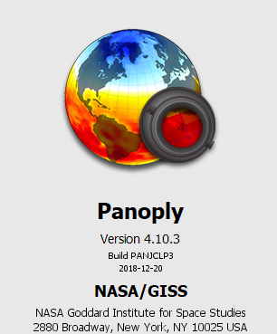

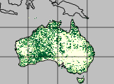
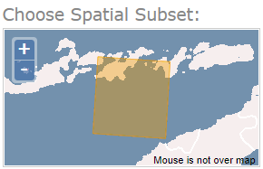
DAP Service in GSKY
GSKY can aggregate NetCDF files
DAP can deliver them to other software for analyses
So, let us combine the two features !
First step:
Create an aggregate output file in NetCDF format
Open it in Panoply or Python Notebook - OK
The objective is to provide a facility to take advantage of the speed of GSKY in collecting the data and creating an aggregate file for analysing the data using other DAP clients a user is familiar with. Python will be the major analysis tool.
Currently Python can read a NetCDF file or a DAP URL to it. It can only handle a single NetCDF file which, though can have multiple time layers, cannot provide an aggregate data as GSKY does. We intend to replace this with a URL that points to GSKY. It should then be possible to define some params and get a datacube, instead of a single layer of time, that is comprised of the layers over a time range.
Next: Provide as NetCDF subset service
APIs to connect directly to GSKY
Send the data in DAP format
End of Slides

Slide 19






Acknowledgements

